Slide 1
SQL Data Analysis Project

Slide 2
INTRODUCTION
Welcome to our Pizza Sales Data Analysis Presentation! Today, we're taking a peek into our sales performance, exploring some interesting insights we've uncovered. It's a simple dive into our journey, highlighting what's been working well and where we can improve.
Join us as we walk through a few queries we've used to understand our sales better. It's not rocket science, just a fun exploration of how data can tell us stories about our pizza sales adventure.
Let's get started and see what interesting nuggets of information we can uncover!

Slide 3

Database Overview
1. Database Name: pizzasales
2. Tables Overview:
pizzas: Contains information about the pizzas offered, including pizza ID, pizza type ID, pizza size, and price.
pizza_types: Stores details about different types of pizzas, such as pizza type ID, name, category, and ingredients.
orders: Holds records of orders placed, including order ID, order date, and time.
order_details: Stores detailed information about each order, including order details ID, order ID, pizza ID, and quantity.

Slide 4
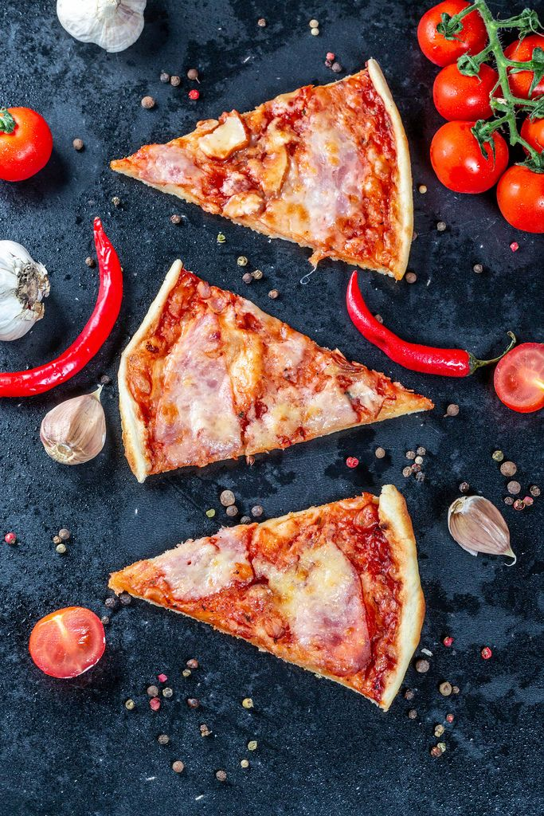
Key Questions for Analysis
1
Retrieve the total number of orders placed.
2
Calculate the total revenue generated from pizza sales.
3
Identify the highest-priced pizza.
4
Identify the most common pizza size ordered.
5
List the top 5 most ordered pizza types with their quantities.
6
Find the total quantity of each pizza category ordered.
7
Determine the distribution of orders by hour of the day.
8
Find the category-wise distribution of pizzas.
9
Calculate the average number of pizzas ordered per day.
10
Determine the top 3 most ordered pizza types based on revenue.
11
Analyze the cumulative revenue generated over time.
12
Calculate the percentage contribution of each pizza type to total revenue.
13
Determine the top 3 most ordered pizza types based on revenue for each pizza category.
This Photo by Unknown Author is licensed under CC BY

Slide 5

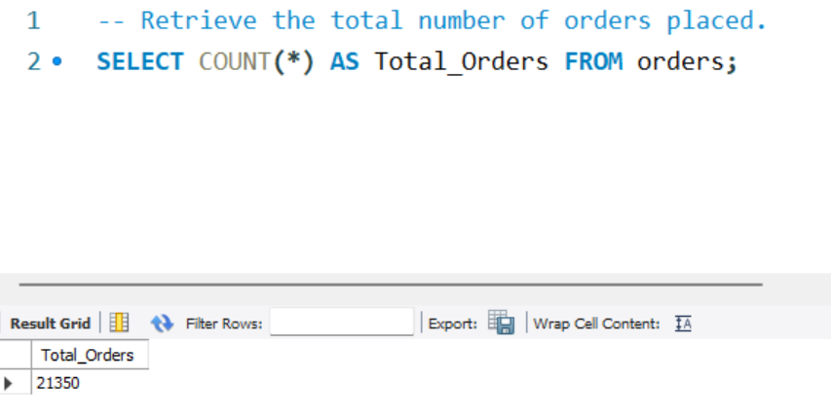
Retrieve the total number of orders placed.

Slide 6
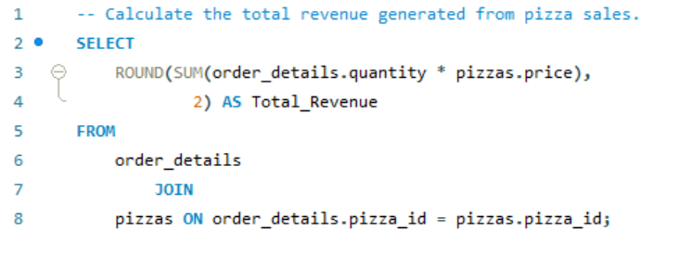
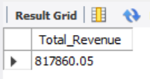
Calculate the total revenue generated from pizza sales.

Slide 7
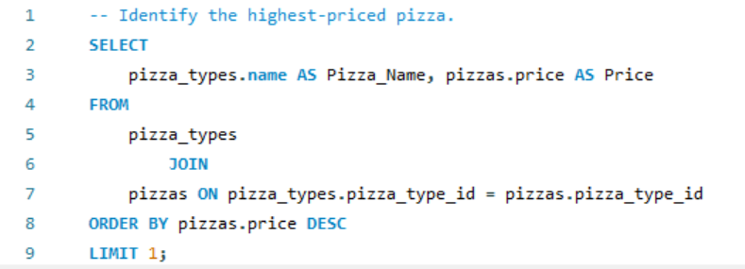
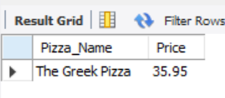
Identify the highest-priced pizza.

Slide 8
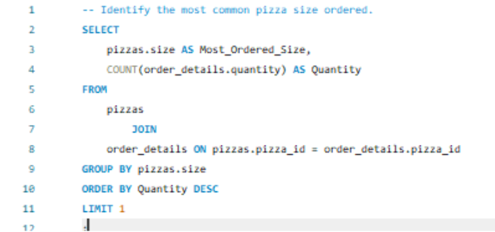
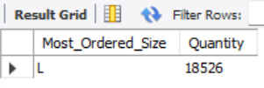
Identify the most common pizza size ordered.

Slide 9
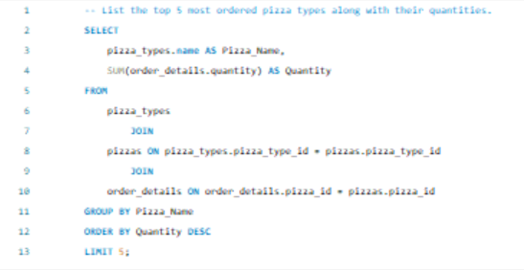
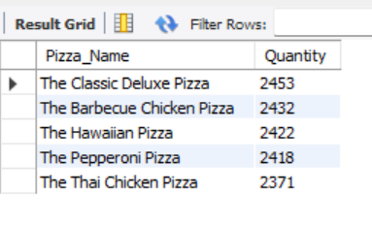
List the top 5 most ordered pizza types along with their quantities.

Slide 10
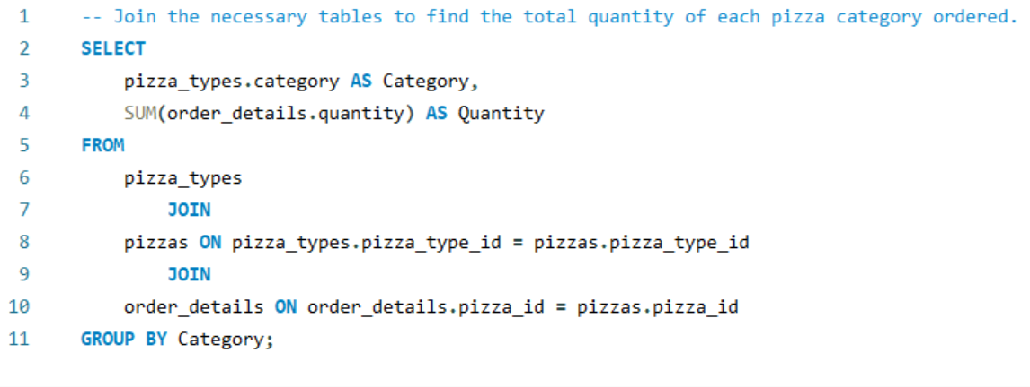
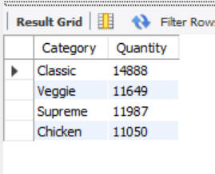
Find the total quantity of each pizza category ordered.

Slide 11
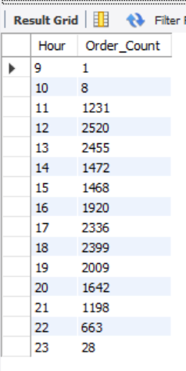
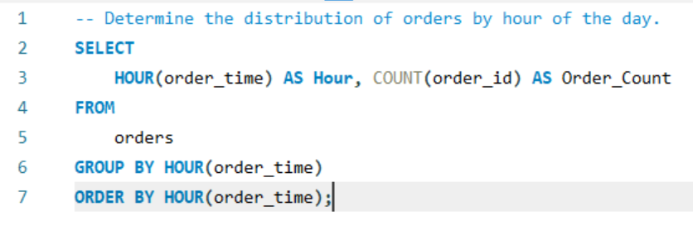
Determine the distribution of orders by hour of the day.

Slide 12
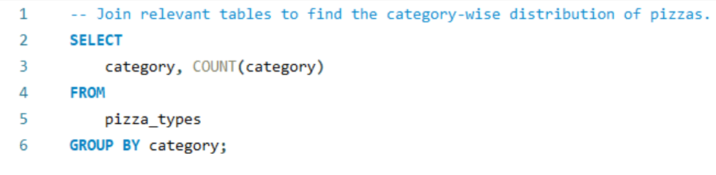
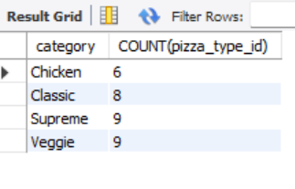
Find the category-wise distribution of pizzas.

Slide 13
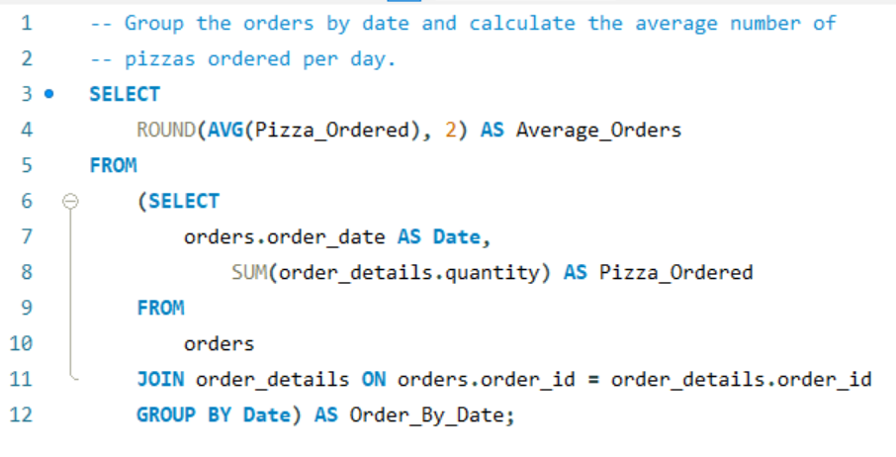
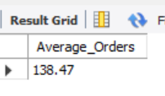
Calculate the average number of pizzas ordered per day.

Slide 14
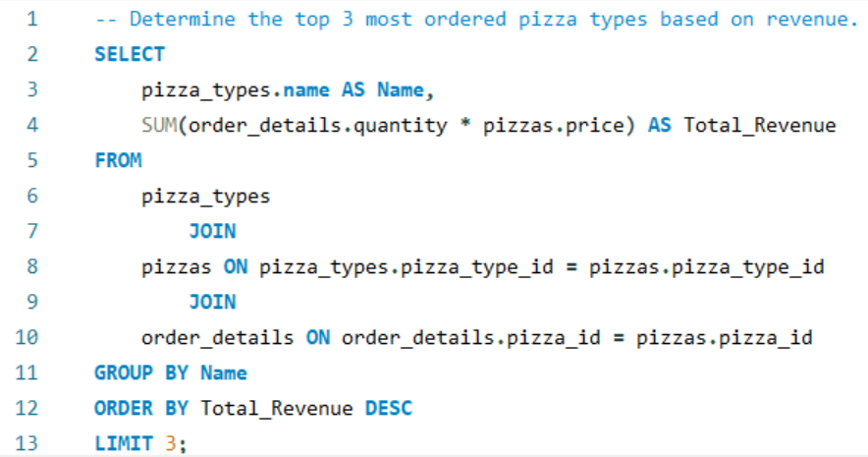
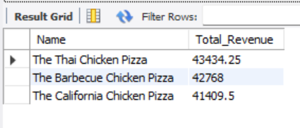
Determine the top 3 most ordered pizza types based on revenue.

Slide 15
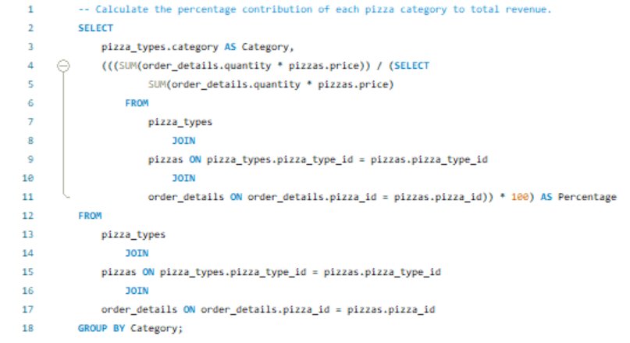
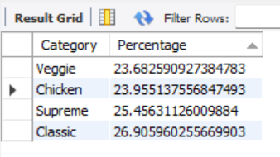
Calculate the percentage contribution of each pizza type to total revenue.

Slide 16
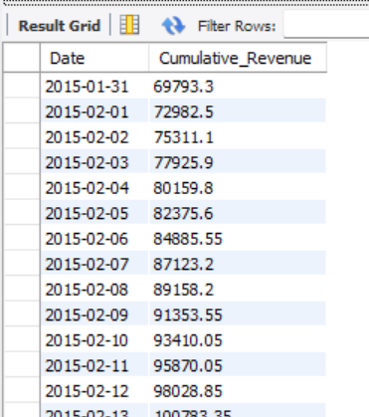
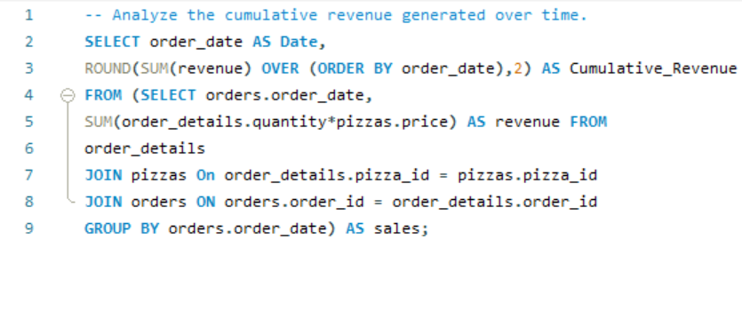
Analyze the cumulative revenue generated over time.

Slide 17
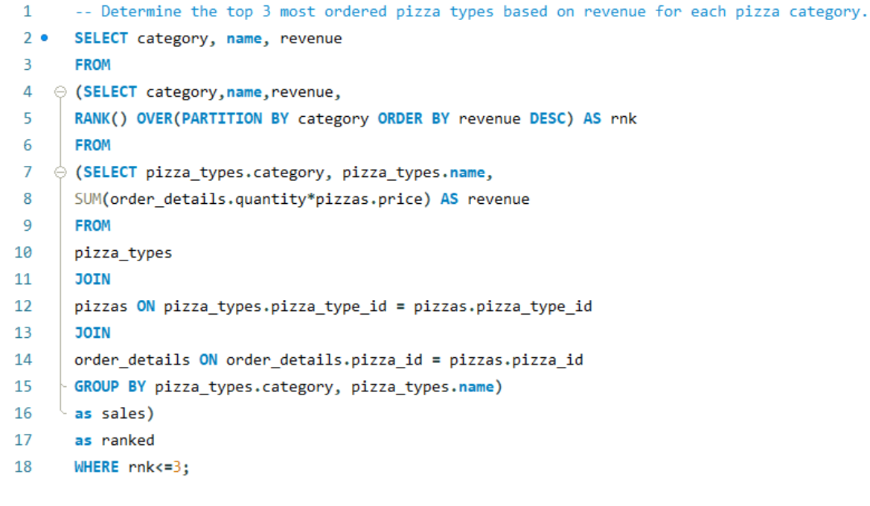
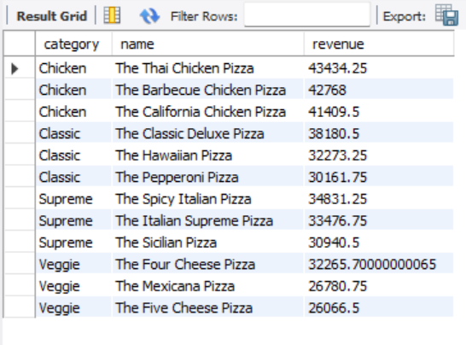
Determine the top 3 most ordered pizza types based on revenue for each pizza category.

Slide 18
THANK YOU

